Slide 1

CET2331
Unix System Administration

Slide 2
Instructor
Dave Cushing
dave.cushing@cambriancollege.ca
Room 3140 (see posted office hours)
(705) 566-8101 x 7493
https://zoom.us (install client and add me as a contact)

Slide 3
Evaluation Criteria
Tests (Skills Based) = 50%
Labs = 20%
Assignments = 20%
Quizzes = 10%

Slide 4
Course Objectives
History of Linux
Key differences between Linux and Windows
What is a distribution?
Managing software in a Ubuntu/Debian environment
Managing users, authentication, and authorization
Linux command line fundamentals

Slide 5

Ready?

Slide 6

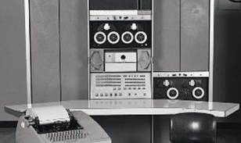
Linux Roots in UNIX
Developed by Ken Thompson and Dennis Ritchie in the 1960's
POSIX compliant (Portable Operating System Interface for Unix)
Multiuser and multitasking
Widely used in academics
Notes:
Dennis Ritchie also developed the C programming language
Dennis died in 2011
Dennis won multiple Computer Science awards in his lifetime including the Turing award

Slide 7
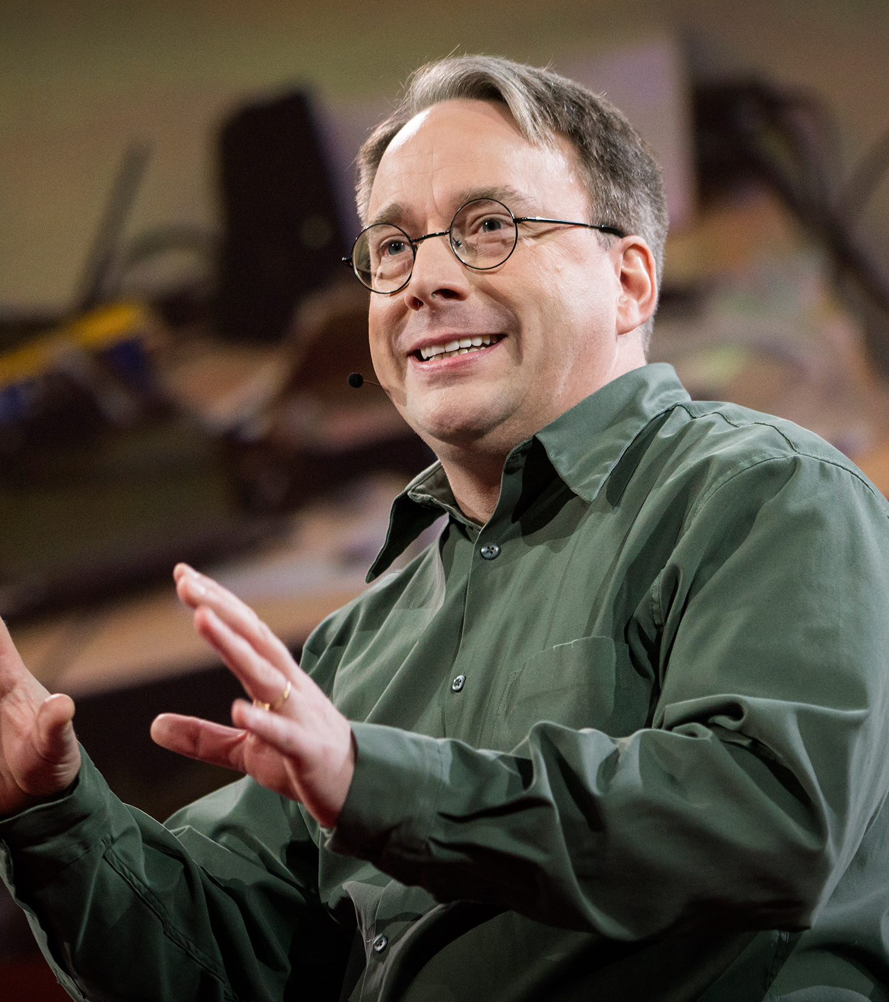
Linux and Linus Torvalds
Initially developed in 1991 by Linus Torvalds in Helsinki Finland
Currently, Linus has personally authored approximately 2% of the linux kernel
Linus selected the GNU General Public License (GPL) for linux
Notes:
On April 23, 2012 at Internet Society's Global INET conference in Geneva, Switzerland, Torvalds was one of the inaugural inductees into the Internet Hall of Fame, one of ten in the Innovators category and thirty-three overall inductees

Slide 8
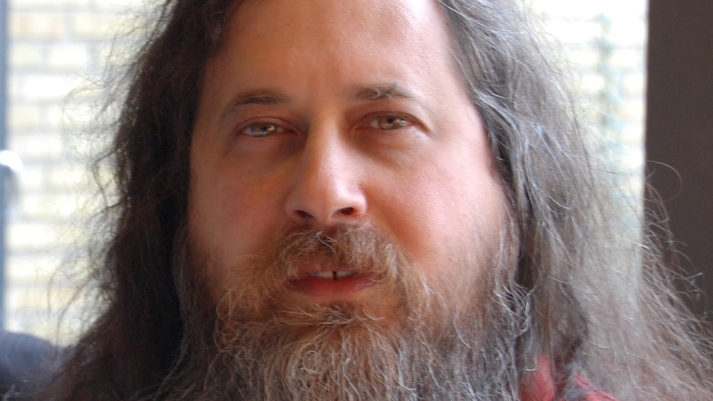
GPL
The GNU General Public License (GNU GPL or simply GPL) is a widely used free software license, originally written by Richard Stallman for the GNU project
“Free software” is a matter of liberty, not price.
To understand the concept, you should think of “free” as in “free speech,” not as in “free beer.”

Slide 9

Open Source Software
“Open source” is a development methodology
Offers practical accessibility to a product’s source (goods and knowledge)
Not “free” software

Slide 10














Linux Distributions (distro)
Notes:
The term “Linux” refers ONLY to the kernel
different manufacturers (distros) put their own patches in the kernel
most will stay fairly current with www.kernel.org
security patches always take priority
a ‘distro’ is made up of all the utilities and programs that use the kernel (ie. desktop, shell, web server, etc.)
Which distro is best depends on what you are looking for.

Slide 11

Linux as a career
Gaining popularity and acceptance in the corporate server room (not desktops, yet)
Linux professionals are more difficult to find than Windows professionals (and paid more)
HUGE amount of open source content for almost any profession
Web development, ISP, web servers, mail servers

Slide 12

Open Source Jobs

Slide 13
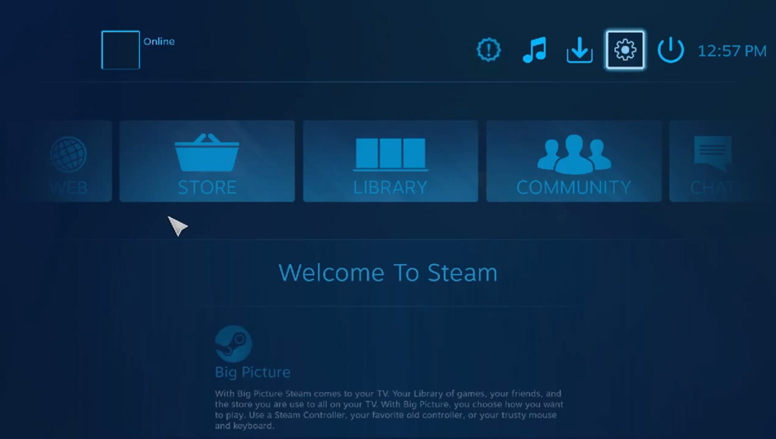
Linux at home
Pro: Developers have tons of free tools and compilers available
Pro: Less susceptible to viruses and malware
Pro: Most popular applications are freely available (browser, office applications, etc.)
Pro: Ubuntu directly on Windows 10
Con: gaming (Valve?)

Slide 14
Linux vs. Windows
Windows
Linux
Single-user (DOS, Windows 9X)
Multi-user/Network User
Active Directory
Microkernel
provides small core while other services provide the bulk
Uses drive letters to address storage
case insensitive file system
Uses registry for configuration
requires regedit
cannot comment a registry entry
Different versions for server/workstation/etc.
Single-user isn’t standard
Multi-user/Network User
LDAP and PAM (pluggable authentication modules)
Monolithich kernel
provides all services to user applications
Uses mount points in the file system to address storage
case sensitive file system
Uses text files for configuration
can be commented
any text editor can be used
Installed software determines function

Slide 15
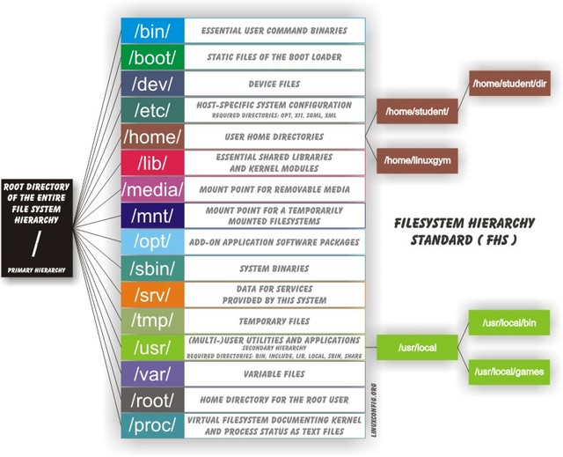
Linux File System

Slide 16
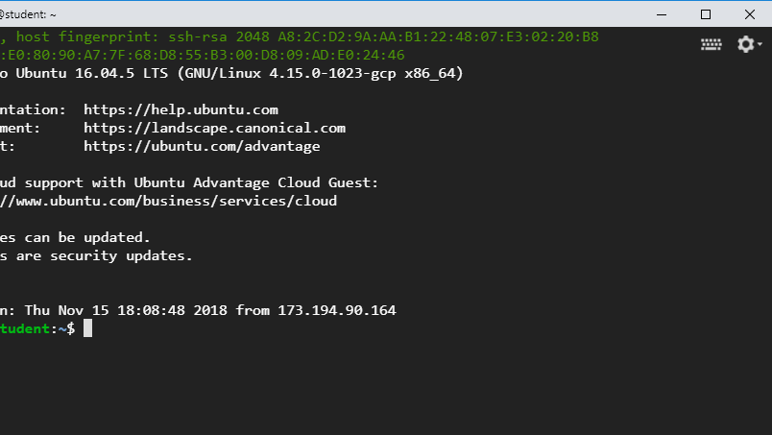
Our Systems
Ubuntu 16.04 LTS (long term support)
Bourne Again SHell (BASH command line)
10 Gb drive space
Google Cloud virtual machine

Slide 17
Summary
Review Chapters 1 & 2
Read Chapter 3
piping, wildcards, redirection, and grep
Always check Moodle for current information/assignments.

